Slide 1

Comic Book Store
Molly Sankey

Slide 2
Comic Book Store
Link to GitHub Repository: https://github.com/MOLLY-S1/Burger-Menu-Combos
Links to Trello board / project management tools: https://trello.com/b/gvJ7x6cS/burger-menu-combos
Link to final version of your program: https://github.com/MOLLY-S1/Burger-Menu-Combos/blob/main/00_Base_Final.py
Ensure you have made these links ‘public’ so that they are open to anyone, including the marker. The link to your program is the final outcome of this whole project – your finished program.

Slide 3
Explain relevant Implications:
Additional rows can be added by clicking in the last cell and then using the Tab key
Relevant implication | Describe the implication and give an example
Social​ | Social implications are about the affect a computer program might have on users, the wider community, and society overall. For example, programs about gambling would be negative. Use clear instructions, and inoffensive feedback.​
Future Proofing​ | Future proofing makes sure a program is flexible, adaptable, and easily modified. A programmer should be able to easily make changes, if it is well set out and commented. They should understand the purpose and reasoning behind the code. It is important to use constants rather than literals.
Notes:
Additional rows can be added by clicking in the last cell and then using the Tab key

Slide 4
Relevant implication | Describe the implication and give an example
Functionality​ | Functionality makes sure the program runs as its supposed to. It should work for all cases including boundary, expected, and unexpected. ​
Usability​ | Usability is how easy the program is to use. Instructions and error messages should be easily understood. Make sure the user does not feel frustrated.​
Aesthetics​ | Aesthetics is how the program looks, and its appearance. An aesthetically pleasing program will contain well spaced instructions, prompts and decorations around key messages.​

Slide 5
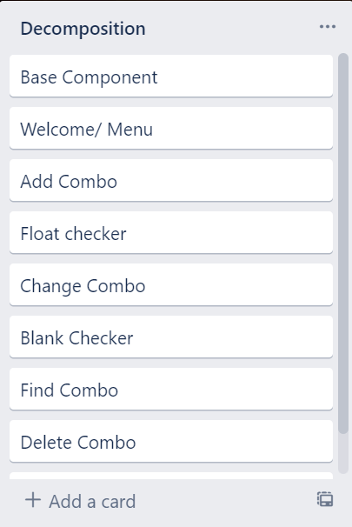
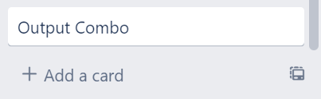
Decomposition:
I will be making a burger combo menu for a takeaway business to store quick burger combos
Notes:
Paste screenshots of your initial Trello board / task decomposition on this slide. If you have a long list, you might need to break it up into several slides.

Slide 6
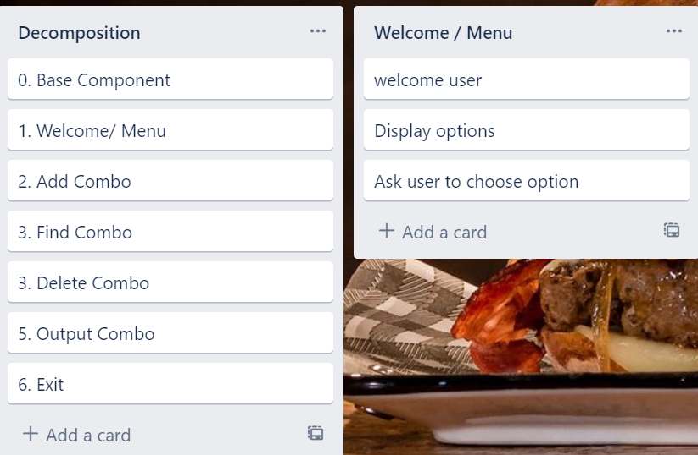
Welcome / Menu

Slide 7
Welcome / Menu - Test Plan
Test Cases - input | Expected output
Add combo | Print “Add Combo”
Find Combo | Print “Find Combo”
Delete Combo | Print “delete Combo”
Output Combo | Print “output Combo”
Exit | Leave program “goodbye”
For testing purposes, I have added print statements as the output. As functions are created, these will be changed
Notes:
Additional rows can be added by clicking in the last cell and then using the Tab key

Slide 8
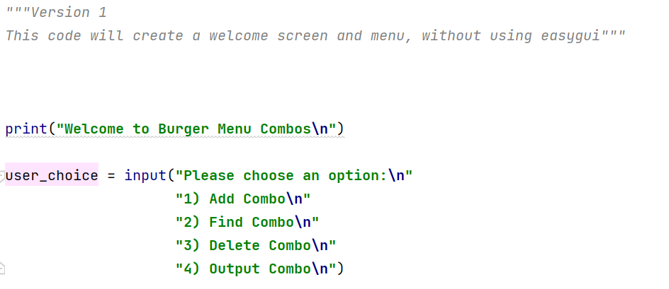
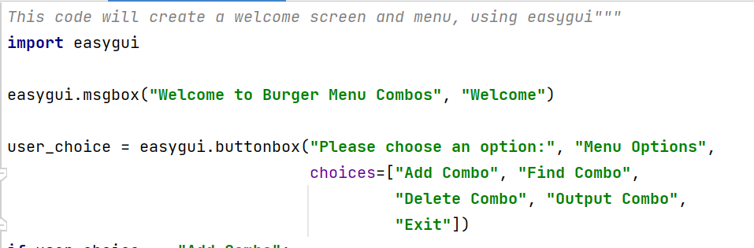
Welcome : Trialling
Trial 1
Trial 2
Trial 2 asks the user to press a button using easygui. Because this version doesn’t need a checker and is more efficient code, I have chosen it as my final code.
Trial 1 asks the user to enter a number for the option they want to select. This is less efficient because it will need a checker to ensure only stings are entered.
Notes:
NOTE: Trialling needs to happen for at least 2 of your components but is not necessary for ALL components.
Trialling is not the same as testing. Trialling is about finding different ways of building the same component. Show evidence of your trialling here. Select one of your trials for further development and give reasons for your choice.

Slide 9
Selecting the best option:
Trial 1 asks user to input a number
Trial 2 uses easygui so only a button needs to be pressed
Trial 2 performed better because it is more user friendly as only a button needs to be pressed (this meets my usability requirement)
I have chosen to use trial 2 because of this and it will be integrated into my program.

Slide 10
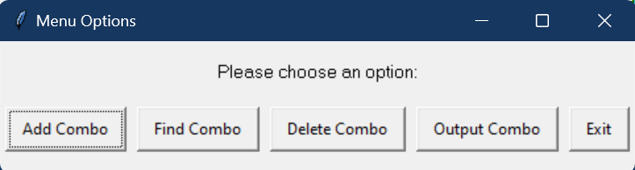
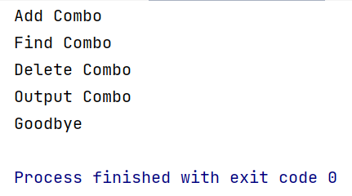
Welcome Testing
All outcomes worked as expected
Test Cases - input | Expected output
Add combo | Print “Add Combo”
Find Combo | Print “Find Combo”
Delete Combo | Print “delete Combo”
Output Combo | Print “output Combo”
Exit | Leave program “goodbye”
Notes:
You must show the results of testing. For each component, include a screenshot proving it works. You can also include notes about each test.

Slide 11
Welcome Development
Trial 1 01_Welcome_V1 | This program ran as expected but, is not effective because the user was able to enter values not part of the menu
Trial 2 01_Welcome_V2 | Adjusted to use easygui for the menu options, Prints results of valid input , Inefficient testing
Trial 3 01_Welome_V3 | Program is now in a loop.
Trial 01 01_Welcome_V4 | Program made from version 3 but is now in a function so that it is easy recycle for other welcome that may be incorporated in the program. This will be apart of my finished program.

Slide 12
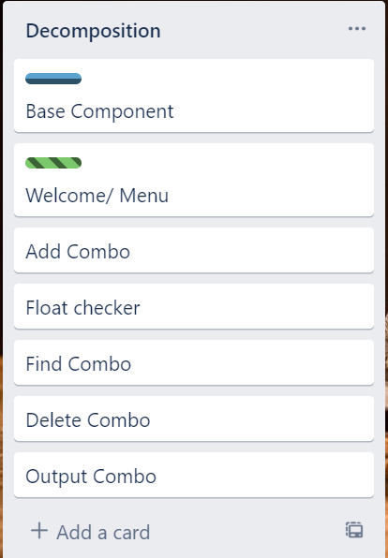
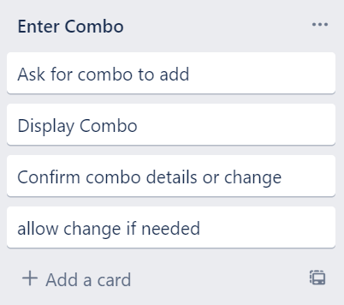
Component 2: Add Combo

Slide 13
Add Combo - Test Plan
Test Cases - input | Expected output
All fields are entered | Program outputs new combo and continues as expected
For testing purposes, I have added print statements as the output. As functions are created, these will be changed
Notes:
Additional rows can be added by clicking in the last cell and then using the Tab key

Slide 14
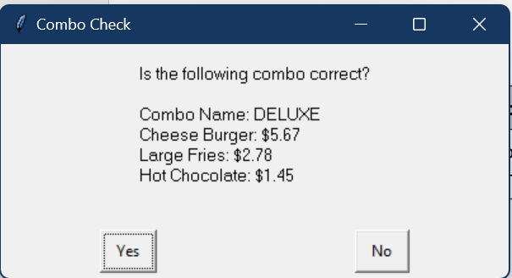
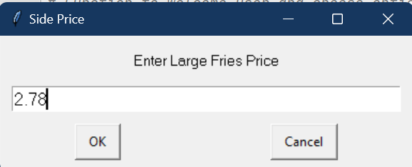
Add Combo - Testing
All outcomes worked as expected
Test Cases - input | Expected output
All fields are entered | Program outputs new combo and continues as expected
Notes:
Additional rows can be added by clicking in the last cell and then using the Tab key

Slide 15
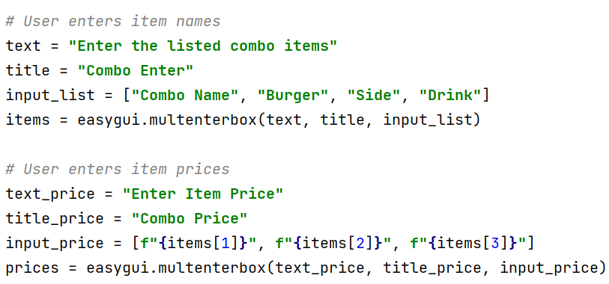
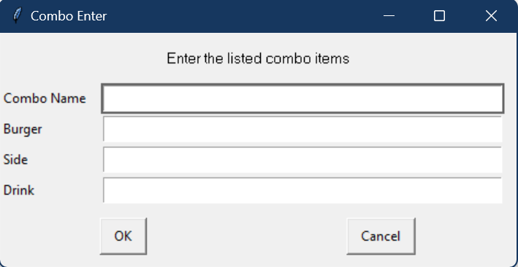
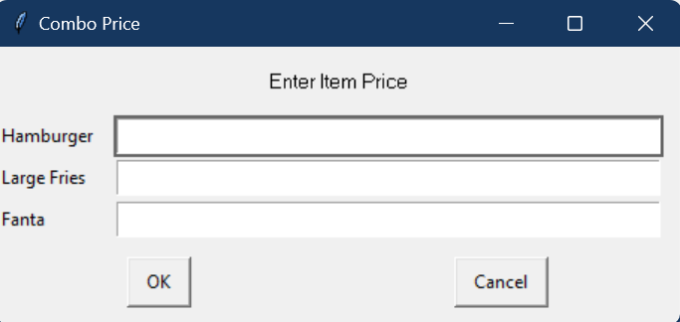
Add Combo : Trialling Part 1
OUTPUT
Trial 1
Trial 1 asks the user to enter the items and prices of the combo using an easygui multi-enterbox. This is more efficient because it is more user friendly / more straightforward to use. Because of this I have chosen this as my final code
Notes:
NOTE: Trialling needs to happen for at least 2 of your components but is not necessary for ALL components.
Trialling is not the same as testing. Trialling is about finding different ways of building the same component. Show evidence of your trialling here. Select one of your trials for further development and give reasons for your choice.

Slide 16
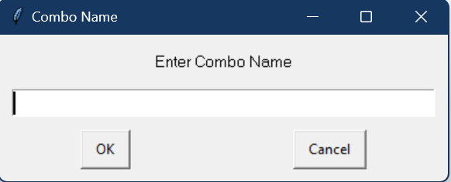
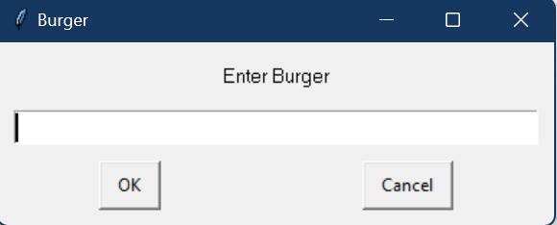
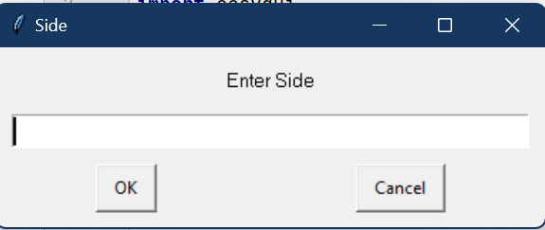
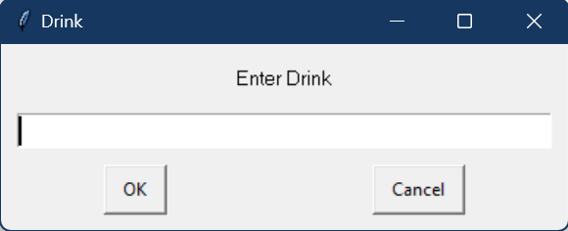
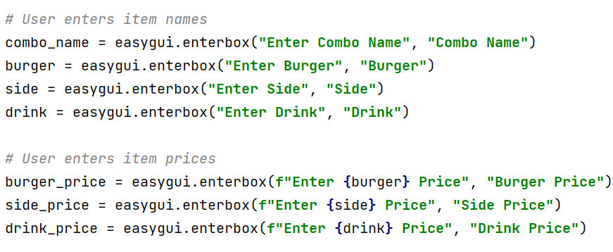
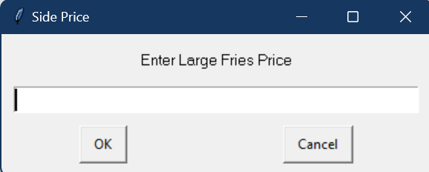
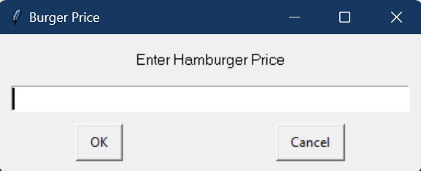
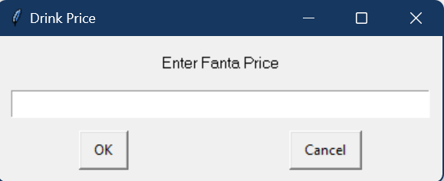
Add Combo: Trialling Part 2
OUTPUT
Trial 2
Trial 2 requires the user to answer 7 sperate enterboxs, 1 for each question. This is less efficient and more confusing for the user. Because of this I have chosen trial 1
Notes:
NOTE: Trialling needs to happen for at least 2 of your components but is not necessary for ALL components.
Trialling is not the same as testing. Trialling is about finding different ways of building the same component. Show evidence of your trialling here. Select one of your trials for further development and give reasons for your choice.

Slide 17
Selecting the best option:
Trial 1 asks user to input using only 2 boxes (1 for items and 1 for price)
Trial 2 uses a different enter-box for each question with clear instructions for what goes in each box (meeting my usability requirement)
Trial 2 performed better as it is more easily integrated into my code/ built on using other functions
I have chosen to use trial 2 because of this and it will be integrated into my program.

Slide 18
Add combo: Development
Trial 1 01_Add_V1 | Trial 1 – uses multienter to enter the combo needed to add
Trial 2 01_Add_V2 | Trial 2 – Same as version 1 but uses different enterboxes for user to add combo, this is my chosen method of entering combos
Trial 3 01_Add_V3 | Now uses the blank checker and float checker (see components 3 and 4)
Trial 4 02_Add_V4 | Ensure user has filled out all boxes
Trial 5 01_Add_V5 | Program made from version 4 but is now in a function so that it is easy recycle for other welcome that may be incorporated in the program. This will be apart of my finished program.

Slide 19
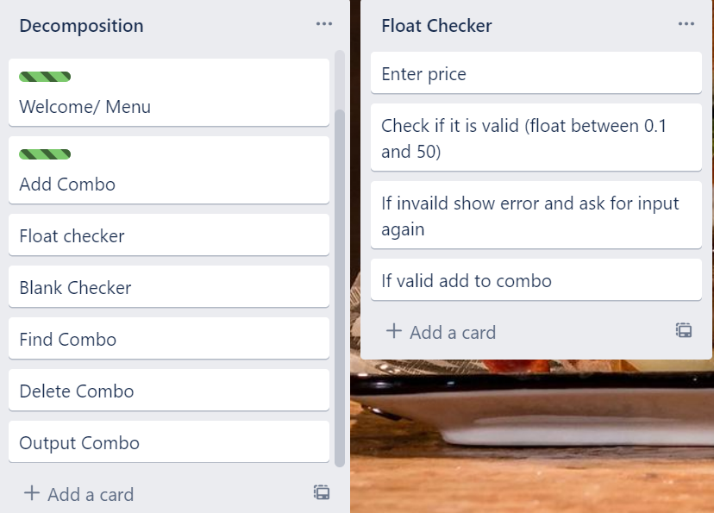
Component 3: Float Checker

Slide 20
Float Checker- Test Plan
Test Cases - input | Expected output
Xxxi (invalid – string) | Error – please enter a float number between 1 and 50
0 (invalid – below lower boundary) | Error – please enter a float number between 1 and 50
51 (invalid – above upper boundary) | Error – please enter a float number between 1 and 50
1 (valid – lower boundary) | Program continues
50 (valid – upper boundary) | Program continues
Notes:
Additional rows can be added by clicking in the last cell and then using the Tab key

Slide 21
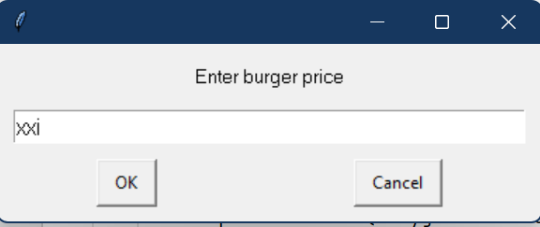
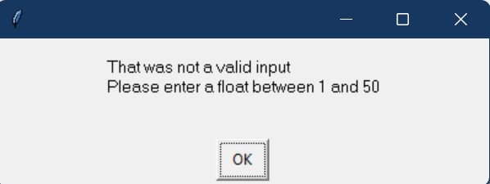
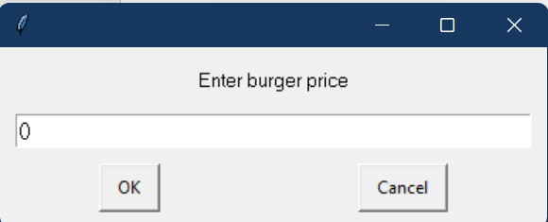
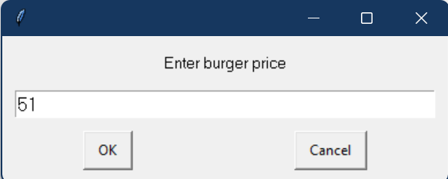
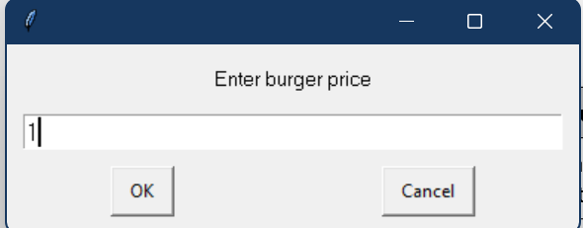

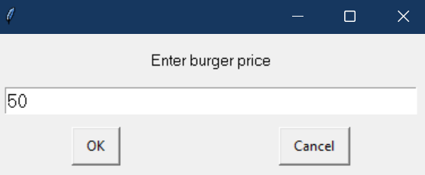
Float Checker Testing
All outcomes worked as expected
Test Cases - input | Expected output
Xxxi (invalid – string) | Error – please enter a float number between 1 and 50
0 (invalid – below lower boundary) | Error – please enter a float number between 1 and 50
51 (invalid – above upper boundary) | Error – please enter a float number between 1 and 50
1 (valid – lower boundary) | Program continues
50 (valid – upper boundary) | Program continues
Notes:
You must show the results of testing. For each component, include a screenshot proving it works. You can also include notes about each test.

Slide 22
Float Checker: Development
Trial 1 03_Checker_V1 | The program works but only if floats are entered between 1 and 50
Trial 2 03_Checker_V2 | The program allows for strings, floats and integers but could be more efficient
Trial 3 03_Checker_V3 | The basis of the program is now a while loop, so it is adaptable and more efficient
Trial 01 03_Checker_V4 | Program made from trial 3 but is now in a function and can be recycled for other components

Slide 23
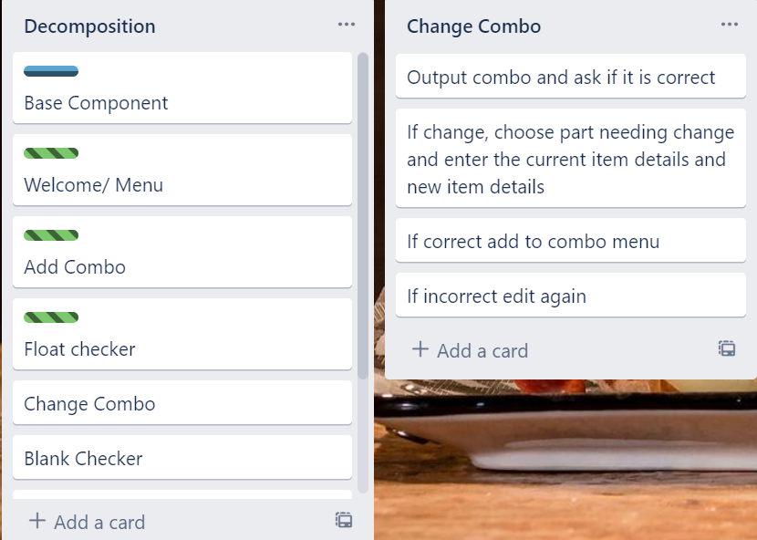
Component 4: Change Combo

Slide 24
Change Combo - Test Plan
Test Cases - input | Expected output
The combo is correct | Program continues to add to combo menu
The combo is incorrect | Program continues to change combo
For testing purposes, I have added print statements as the output. As functions are created, these will be changed
Notes:
Additional rows can be added by clicking in the last cell and then using the Tab key

Slide 25
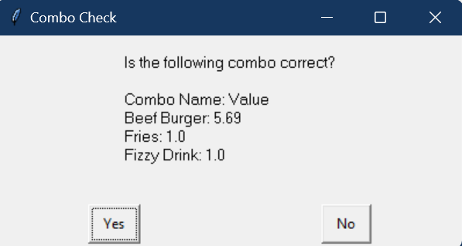
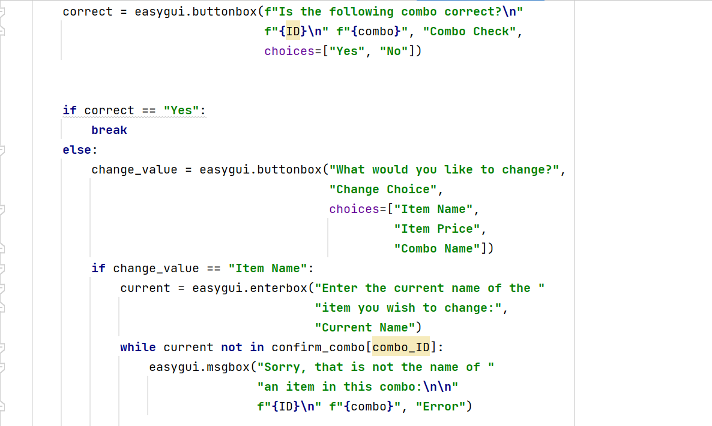
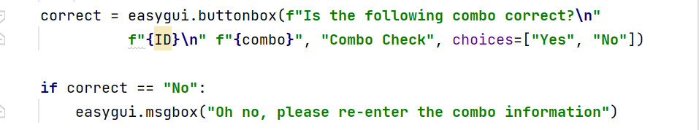
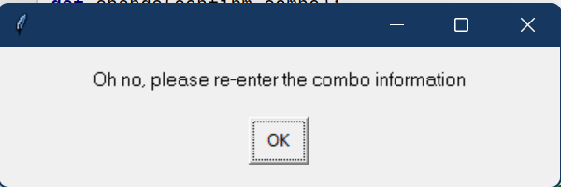
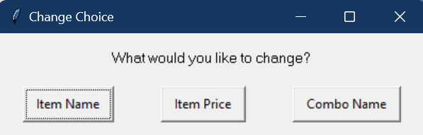
Change combo : Trialling
Trial 1
Trial 2
Trial 2 asks the user to re-enter the entire combo if any part is incorrect. This is an extremely inefficient program that could easily become tedious and frustrating for the user, so I have not chosen this version.
Trial 1 requires the user to enter the part of the combo they wish to change then the current name of element to be edited before entering the new details. This is an efficient program that is much more user friendly. Because
Of this I have
chosen to use this
Trial in the final
Code.
Notes:
NOTE: Trialling needs to happen for at least 2 of your components but is not necessary for ALL components.
Trialling is not the same as testing. Trialling is about finding different ways of building the same component. Show evidence of your trialling here. Select one of your trials for further development and give reasons for your choice.

Slide 26
Selecting the best option (confirm):
Trial 1 asks user to input the name of the item or item price they wish to change. The user then enters what they want this changed to and is asked if the combo is correct again
Trial 2 asks the user to confirm the combo at the end of adding. If the combo added is incorrect, then the user must add the entire combo again. This could be problematic if any aspect of the combo is entered incorrectly a multiple times as it means the whole combo must be entered multiple times.
Trial 1 performed better because it is more user friendly as it allows the user to change specific parts of the combo without having to re-enter the entire combo (this meets my usability requirement).
I have chosen to use trial 1 because of this and it will be integrated into my program.

Slide 27
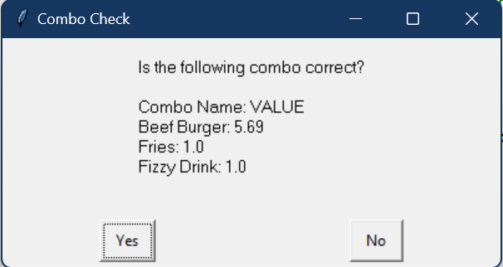
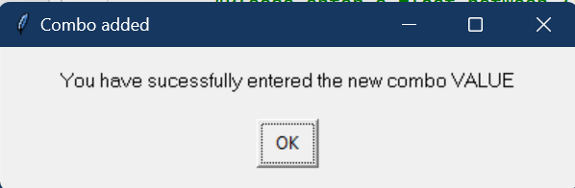
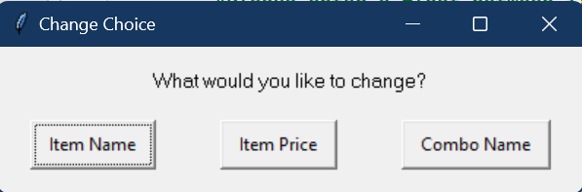
Change Combo – Testing Part 1
Test Cases - input | Expected output
The combo is correct | Program continues to add new combo to combo menu
The combo is incorrect | Program continues to allow user to continue editing different aspects of the combo
All outcomes worked as expected
Notes:
Additional rows can be added by clicking in the last cell and then using the Tab key

Slide 28
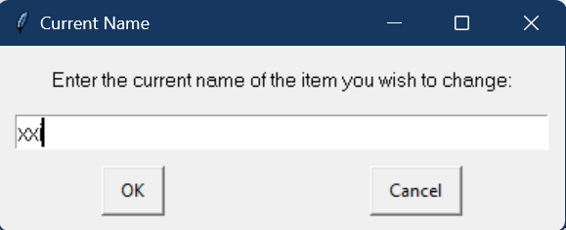
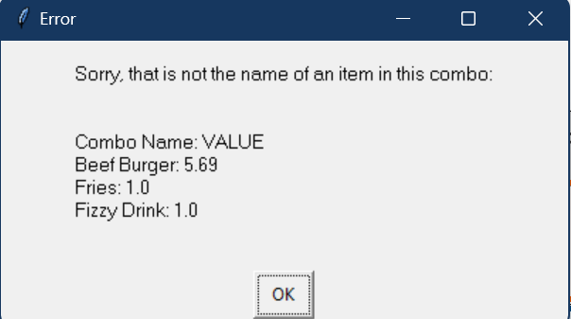
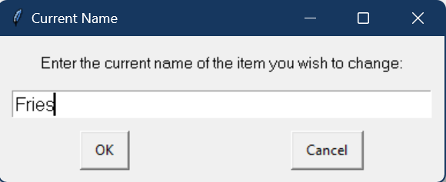
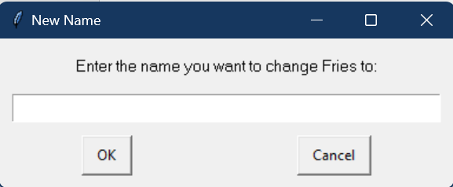
Change Combo – Testing Part 2 (Item name)
All outcomes worked as expected
Test Cases - input | Expected output
Xxi | <error> that is not an item name in this combo
“Fries” – item name in combo | Program continues
Notes:
Additional rows can be added by clicking in the last cell and then using the Tab key

Slide 29
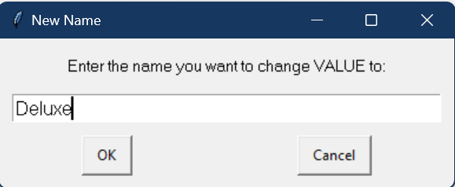
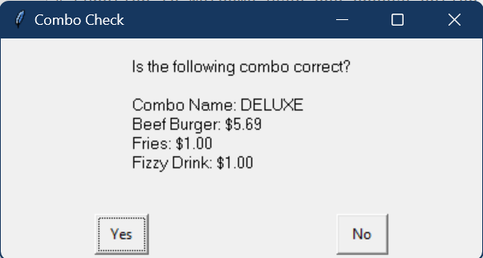
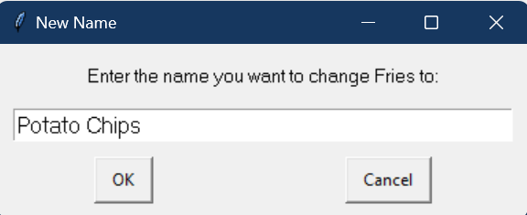
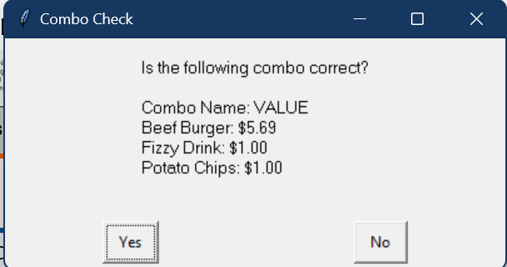
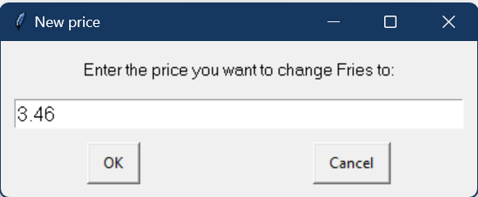
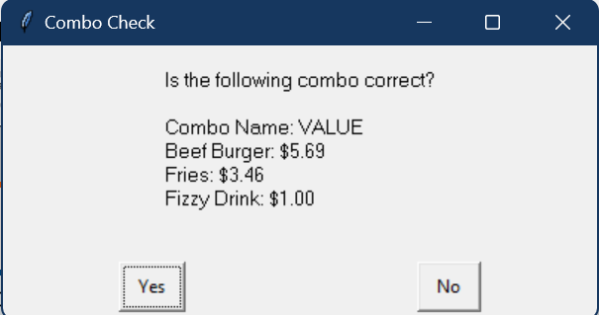
Change Combo – Testing Part 3 (new info added)
All outcomes worked as expected
Original Combo
Test Cases - input | Expected output
DELUXE – combo name | Program continues – combo is updated
Potato Chips – combo item | Program continues – combo is updated
3.46 – item price | Program continues – combo is updated
Notes:
Additional rows can be added by clicking in the last cell and then using the Tab key

Slide 30
Change Combo: Development
Trial 1 03_Checker_V1 | Trial 1 – function that allows the user to change a specific part of the combo without re-entering the whole thing
Trial 2 03_Checker_V2 | Trial 2 – makes the user re-enter whole combo if incorrectly entered
Trial 3 03_Checker_V3 | The program now incorporates the blank and float checkers

Slide 31
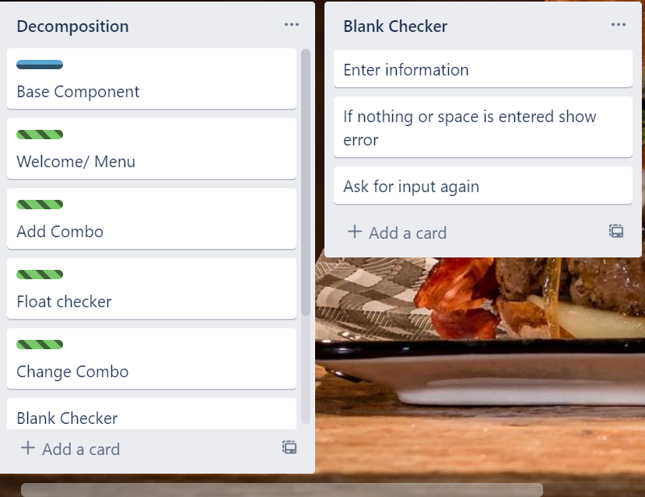
Component 5: Blank Checker

Slide 32
Blank Checker- Test Plan
Test Cases - input | Expected output
“”(nothing entered) | Error – That was not a valid input, Please answer all questions
“”(space entered) | Error – That was not a valid input, Please answer all questions
51 (valid float) | Program continues
potato (valid –string) | Program continues
Notes:
Additional rows can be added by clicking in the last cell and then using the Tab key

Slide 33
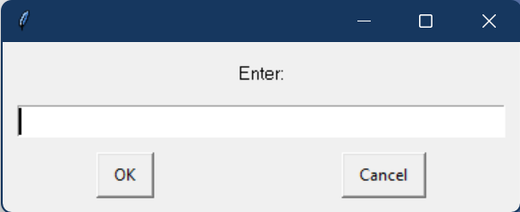






Blank Checker Testing
All outcomes worked as expected
Test Cases - input | Expected output
“”(nothing entered) | Error – That was not a valid input, Please answer all questions
“”(space entered) | Error – That was not a valid input, Please answer all questions
51 (valid float) | Program continues
potato (valid –string) | Program continues
Notes:
You must show the results of testing. For each component, include a screenshot proving it works. You can also include notes about each test.

Slide 34
Blank Checker: Development
Trial 1 05_Blank_Checker_V1 | If nothing is entered error is shown
Trial 2 05_Blank_Checker_V2 | The program uses a try and except loop to pull messages out
Trial 3 05_Blank_Checker_V3 | Program made from trial 3 but is now in a function and can be recycled for other components

Slide 35

Component 6: Find Combo

Slide 36
Find Combo - Test Plan
Test Cases - input | Expected output
“xxi” | <error> “Sorry, xxi is not in the menu”, Ask question again
“Value” | Program continues to confirm
For testing purposes, I have added print statements as the output. As functions are created, these will be changed
Notes:
Additional rows can be added by clicking in the last cell and then using the Tab key

Slide 37





Find Combo – Testing
All outcomes worked as expected
Test Cases - input | Expected output
“xxi” | <error> “Sorry, xxi is not in the menu”, Ask question again
“Value” | Program continues to confirm
Notes:
Additional rows can be added by clicking in the last cell and then using the Tab key

Slide 38
Find combo: Development
Trial 1 06_Find_Combo_V1 | Allows the user to search the menu for a combo and tells them if it is in the menu or not
Trial 2 06_Find_Combo_V2 | Adds the change combo function if the comb is in the menu, see function 5
Trial 3 06_Find_Combo_V3 | Blank checker has been incorporated and replaces the changed combo in the menu
Trial 4 06_Find_Combo_V4 | If combo name is not in the menu then the program will prompt the user to continue entering the combo name until a valid input is entered.
Trial 5 06_Find_Combo_V5 | Program made from version 4 but is now in a function so that it is easy recycle for other find combo function that may be incorporated in the program. This will be apart of my finished program.

Slide 39

Component 7: Delete Combo

Slide 40
Delete Combo - Test Plan
Test Cases - input | Expected output
xxi | <error> “Sorry, xxi is not in the menu”, Ask question again
“Value” | Program continues to delete
For testing purposes, I have added print statements as the output. As functions are created, these will be changed
Notes:
Additional rows can be added by clicking in the last cell and then using the Tab key

Slide 41



Delete Combo – Testing
Test Cases - input | Expected output
xxi | <error> “Sorry, xxi is not in the menu”, Ask question again
“Value” | Program continues to delete
All outcomes worked as expected
Notes:
Additional rows can be added by clicking in the last cell and then using the Tab key

Slide 42
Delete combo: Development
Trial 1 07_Delete_Combo_V1 | Display full menu, user enters combo to delete
Trial 2 07_Delete_Combo_V2 | Adds the confirmation statement, ensuring user knows deletion cannot be undone and blank checker incorperated
Trial 3 07_Delete_Combo_V3 | Program made from version 2 but is now in a function so that it is easy recycle for other delete combo function that may be incorporated in the program. This will be apart of my finished program.

Slide 43

Component 8: Output Combo

Slide 44
Output Combo - Test Plan
Test Cases - input | Expected output
Output is chosen | Full menu with prices is shown
For testing purposes, I have added print statements as the output. As functions are created, these will be changed
Notes:
Additional rows can be added by clicking in the last cell and then using the Tab key

Slide 45

Output Combo - Testing
Test Cases - input | Expected output
Output is chosen | Full menu with prices is shown
All outcomes worked as expected
Notes:
Additional rows can be added by clicking in the last cell and then using the Tab key

Slide 46
Output Combo: Development
Trial 1 08_Output_Combo_V1 | Display full menu
Trial 2 08_Output_Combo_V2 | Display full menu with prices and formatted nicely
Trial 3 08_Output_Combo_V3 | Program made from version 2 but is now in a function so that it is easy recycle for other delete combo function that may be incorporated in the program. This will be apart of my finished program.

Slide 47

Assembled Outcome Testing: Part 1
Test Cases - input | Expected output
Run program | Welcome and Full screen of options is shown
All outcomes worked as expected
Notes:
Show testing for your assembled outcome below. This should include a test plan followed by screenshot proof.

Slide 48
Assembled Outcome Testing: Part 2 (Add Combo)
Test Cases - input | Expected output
Add combo is entered Enter combo name “” “value” xxi | Program continues Error Error Enter item name
Enter {item} price xxi 2.34 | Error Confirm combo
Notes:
Show testing for your assembled outcome below. This should include a test plan followed by screenshot proof.

Slide 49










Assembled Outcome Testing: Part 2 (Add Combo)
All outcomes worked as expected
Notes:
Show testing for your assembled outcome below. This should include a test plan followed by screenshot proof.

Slide 50
Assembled Outcome Testing: Part 3 (Change Combo)
Test Cases - input | Expected output
Combo correct = yes Combo correct = no | Add combo to menu Change combo options
Change combo = Item name “xxi” “Fries” “Potato Fries” | Current name: Error New Name: Change combo
Change combo = Item price “xxi” “Fizzy Drink” “51” “0” 2.34 | Current name: Error New price: Error Error Change combo
Change combo = Combo name “Deluxe” | New name: Change combo
Notes:
Show testing for your assembled outcome below. This should include a test plan followed by screenshot proof.

Slide 51















Assembled Outcome Testing: Part 3 (Change Combo)
Original combo
All outcomes worked as expected
Notes:
Show testing for your assembled outcome below. This should include a test plan followed by screenshot proof.

Slide 52




Assembled Outcome Testing: Part 4 (Find Combo)
Test Cases - input | Expected output
Find combo is entered “xxi” “value” | Enter combo name Error Change combo
All outcomes worked as expected
Notes:
Show testing for your assembled outcome below. This should include a test plan followed by screenshot proof.

Slide 53
Assembled Outcome Testing: Part 5 (Delete Combo)
Test Cases - input | Expected output
Find combo is entered “xxi” “value” | Enter combo name Error Are you sure
Sure = yes | Delete combo
Sure = no | Return to options
Notes:
Show testing for your assembled outcome below. This should include a test plan followed by screenshot proof.

Slide 54






Assembled Outcome Testing: Part 5 (Delete Combo)
All outcomes worked as expected
Notes:
Show testing for your assembled outcome below. This should include a test plan followed by screenshot proof.

Slide 55



Assembled Outcome Testing: Part 6 (Output Combo and exit)
Test Cases - input | Expected output
Output combo is entered | Full menu is shown with prices
Exit is entered | Goodbye!
All outcomes worked as expected
Notes:
Show testing for your assembled outcome below. This should include a test plan followed by screenshot proof.

Slide 56
Address relevant Implications:
Relevant implication | Explain how your final outcome addresses each implication
Functionality | I have comprehensively tested my final project to ensure the functionality has been addressed. This means that it will allow expected and unexpected cases.
Usability | The inclusion of error messages and instructions throughout this program have been used, ensuring that the outcome is easy to use.
Aesthetics | The program has a carefully spaced output and used a statement formatter to enhance the appearance. Although aesthetics is not the main focus of text-based programs it helps by addressing the usability implication as it adds emphasis to important statements.
Social | Clear instructions and inoffensive feedback is given, this addresses the issue of social implications.
Future proofing | I avoided the use of literals and used functions to make my code flexible and adaptable for the future. It is also well documented so that a programmer in the future will know what each piece of code does.

Slide 57



Version Control Evidence:
Notes:
Your version control evidence should go here. This could be in the form of screenshots (both of your GitHub repository as well as your local project folder) as evidence of your incremental development.

Slide 58



Version Control Evidence:
Notes:
Your version control evidence should go here. This could be in the form of screenshots (both of your GitHub repository as well as your local project folder) as evidence of your incremental development.

Slide 59




End User Testing
When talking with users about my final problems there was a few problems found:
Some of the output combo message did not have a title:
Whenever an option (e.g. Add Combo, Output Combo) is finished, and the user is taken back to the options screen the welcome message would appear. I have changed this by removing the piece of code displaying welcome from within the function, it is now in the main routine:
Notes:
Your version control evidence should go here. This could be in the form of screenshots (both of your GitHub repository as well as your local project folder) as evidence of your incremental development.

Slide 60

Pep8 check:
No pep8 errors shown
Notes:
Discuss how the information from planning, testing and trialling of components assisted in the development of a high-quality outcome.

Slide 61
Final Discussion:
Throughout making this code I have tested and trialed every component as a standalone function/piece of code and as a full program
By decomposing the problem, I was able to focus on creating each chunk of code on its own and testing to make sure that it was finished before I began the next. Each of these smaller chunks were thoroughly tested before being added to the base component.
Through testing I have been able to find and fix any flaws in my code before they were combined into a full program.
Through having other people (not in this class) test my program I was able to find out how to improve its functionality and gain ideas on how to make it more user friendly. This improved the quality of my finished program.
I have also applied all relevant implications that I stated to my code. This makes the code a higher quality and more user friendly
By making a large program smaller by using functions I have been able to code my program more efficient overall.
I have tested my code using the PP8 checker on pycharm to make sure it met the conventions regarding space and layout.
Notes:
Discuss how the information from planning, testing and trialling of components assisted in the development of a high-quality outcome.

